Slide 1
CHAPTER 14
PATTERNS

Slide 2
Chapter Topics
Concepts of pattern and pattern language.
Design patterns.
Analysis patterns.
Modeling patterns.
Anti-patterns.
14- <number>

Slide 3
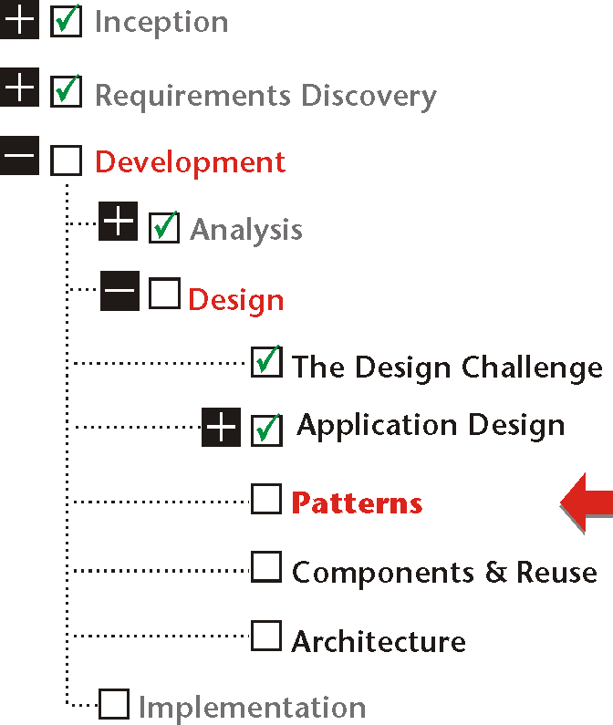
14- <number>

Slide 4
Patterns
Pattern is the core of the solution to a problem that occurs repeatedly in an environment.
Pattern relies on the understanding that many problems, or their components, are repeated and therefore they can be handled by similar solutions.
14- <number>

Slide 5
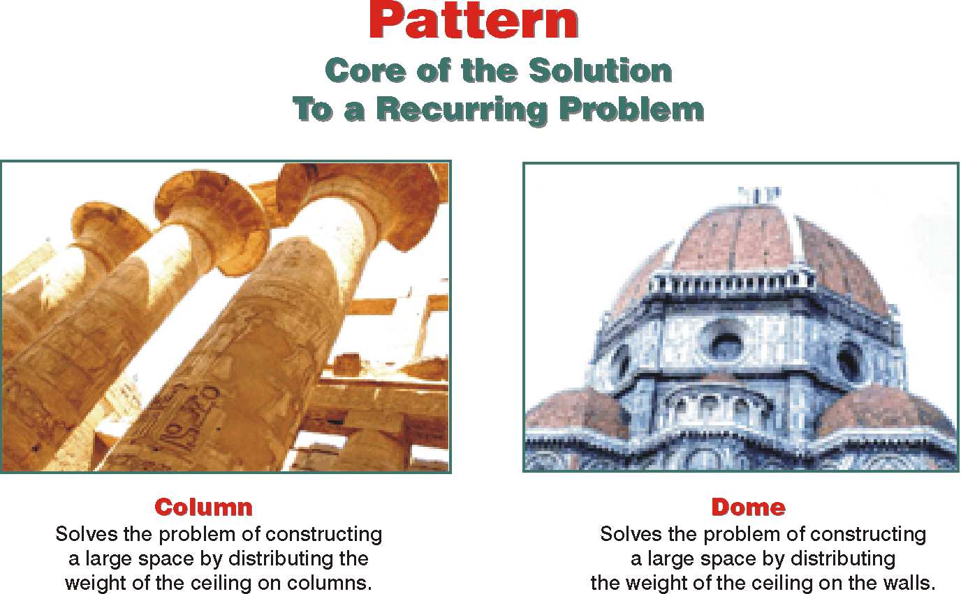
14- <number>

Slide 6
Patterns
Patterns are old. A systematic way to describe patterns and their consequences is new.
Application of patterns to software design, both in theory and practice, started in the late 1970s and early 1980s.
An object-oriented pattern is an abstraction of a doublet, triplet, or other small grouping of classes that is likely to be helpful again and again in object-oriented development.
14- <number>

Slide 7
The Pattern Language
Pattern language has two meanings:
❶ the language for systematizing and presenting patterns.
❷ the language that patterns form in relationship to each other.
14- <number>

Slide 8
What is a pattern?
Patterns = problem/solution pairs in context
Patterns facilitate reuse of successful software architectures and design
Not code reuse
  Instead, solution/strategy reuse
  Sometimes, interface reuse

Slide 9
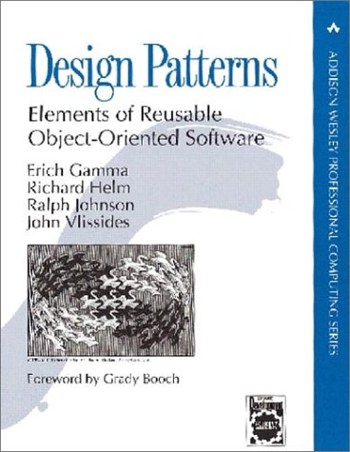
Gang of Four
The book that started it all
Community refers to authors as the “Gang of Four”
Figures and some text in these slides come from book

Slide 10
Patterns
patterns must be described in an essentially literary form.
  Name
    A name for the pattern.
      “Flyweight,” “Singleton,” or “Memento,” for example. Others may use more descriptive names such as “Many-to-Many Class Trio.” Each pattern might also have aliases or other names.
  Problem
    What problem this pattern is to resolve?
      “How to model the relationship between two classes that have many to many associations to each other.”
  Context
    What environment the pattern needs to be successful? What technology, or architecture is required? Explaining the context is of crucial importance to the application of patterns.
  Forces
    What forces create the problem? How are they affected by the application of the pattern.
14- <number>

Slide 11
Patterns
Solution
    What should be done to solve the problem?
Example
    An example of the pattern. If the context is language-specific, then the example might include code as well.
Participants
    What classes or objects participate in the pattern.
Resulting Context and Consequences
    What is the new context as a result of applying the pattern?
Discussion
    An overall view of everything about the pattern.
14- <number>

Slide 12
The Risks
Patterns must be used only with a thorough understanding of the problem, the context and the consequences of applying the pattern.
14- <number>

Slide 13
Design Patterns
Creational Patterns
  help make a system independent of how objects are created, composed, and represented.
Structural Patterns
  define how the building blocks of an object-oriented system — classes and/or objects — can be combined to form larger structures.
Behavioral Patterns
  address the communication and the assignment of responsibilities among objects.
Data Access Patterns
  propose frameworks for handling issues of communication between the object space (the application) and the data space (the database).
Architectural Patterns
  focus on the organization and the responsibilities of major components within the information system.
14- <number>

Slide 14
Creation Patterns

Slide 15
Factory Method
The Factory Method pattern defines an interface for creating objects, but delegates the actual responsibility for selecting the class and instantiating the object to a subclass.
Builder Method – for building complex objects incrementally
Prototype – Cloning new instances from a prototype
14- <number>

Slide 16
Creation patterns
Singleton
  Ensure a class only has one instance, and provide a global point of access to it.
Typesafe Enum
  Generalizes Singleton: ensures a class has a fixed number of unique instances.
Abstract Factory
  Provide an interface for creating families of related or dependent objects without specifying their concrete classes.
CMSC 433, FALL 2002

Slide 17
Structural Patterns

Slide 18
Structural patterns
Adapter
  Convert the interface of a class into another interface clients expect. Adapter lets classes work together that couldn't otherwise because of incompatible interfaces
Proxy
  Provide a surrogate or placeholder for another object to control access to it
Decorator
  Attach additional responsibilities to an object dynamically
CMSC 433, FALL 2002

Slide 19
Structural patterns
Bridge method : Abstraction for binding one of many implementations
Composite : Structure for building recursive aggregations
Facade – simplifies the interface for the subsystem
Flyweight - many fine grained objects shared efficiently
14- <number>

Slide 20
Behavioral Patterns

Slide 21
Behavioral patterns
Template
  Define the skeleton of an algorithm in an operation, deferring some steps to subclasses
State
  Allow an object to alter its behavior when its internal state changes. The object will appear to change its class
Observer
  Define a one-to-many dependency between objects so that when one object changes state, all its dependents are notified and updated automatically
CMSC 433, FALL 2002

Slide 22
Behavioral patterns
Iterator – aggregate elements to access them sequentially
Interpreter – small grammar translator
Chain of responsibility – request delegated to the responsible service provider
14- <number>

Slide 23
Examples

Slide 24
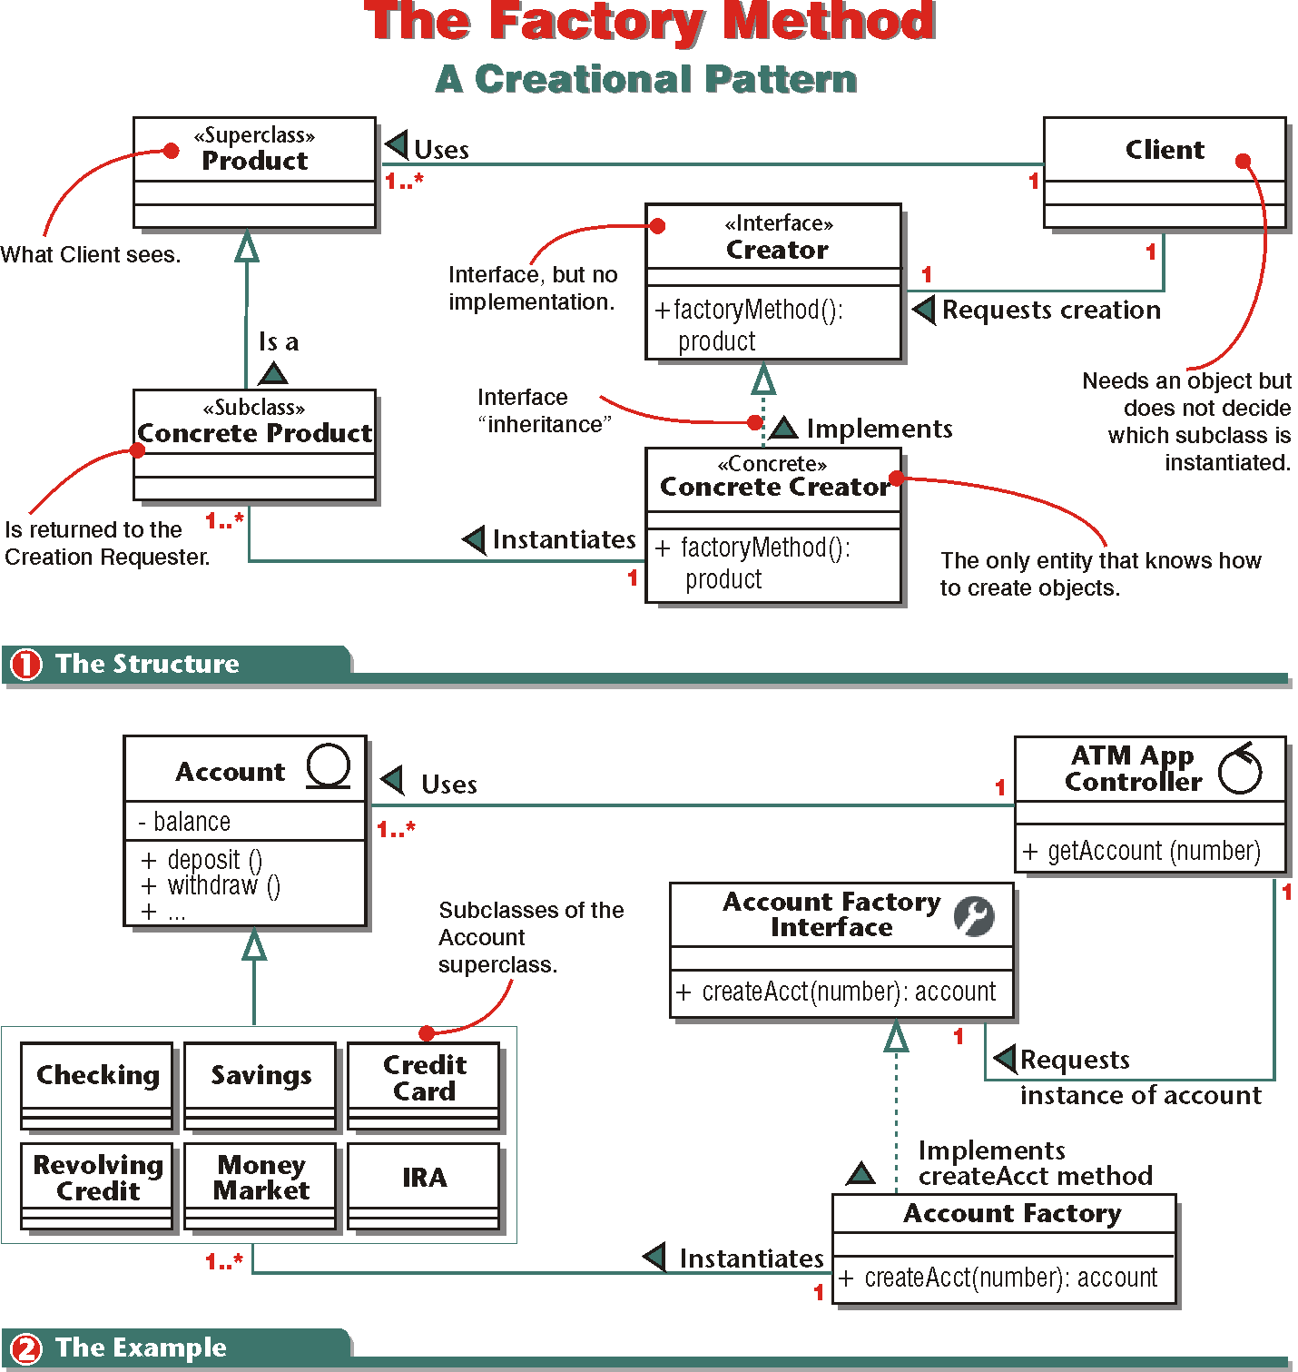
14- <number>

Slide 25
The Object Adapter
The Object Adapter converts the interface of a class into another interface that the clients expect.
Adapter lets classes work together that couldn’t otherwise because of incompatible interfaces.
14- <number>

Slide 26
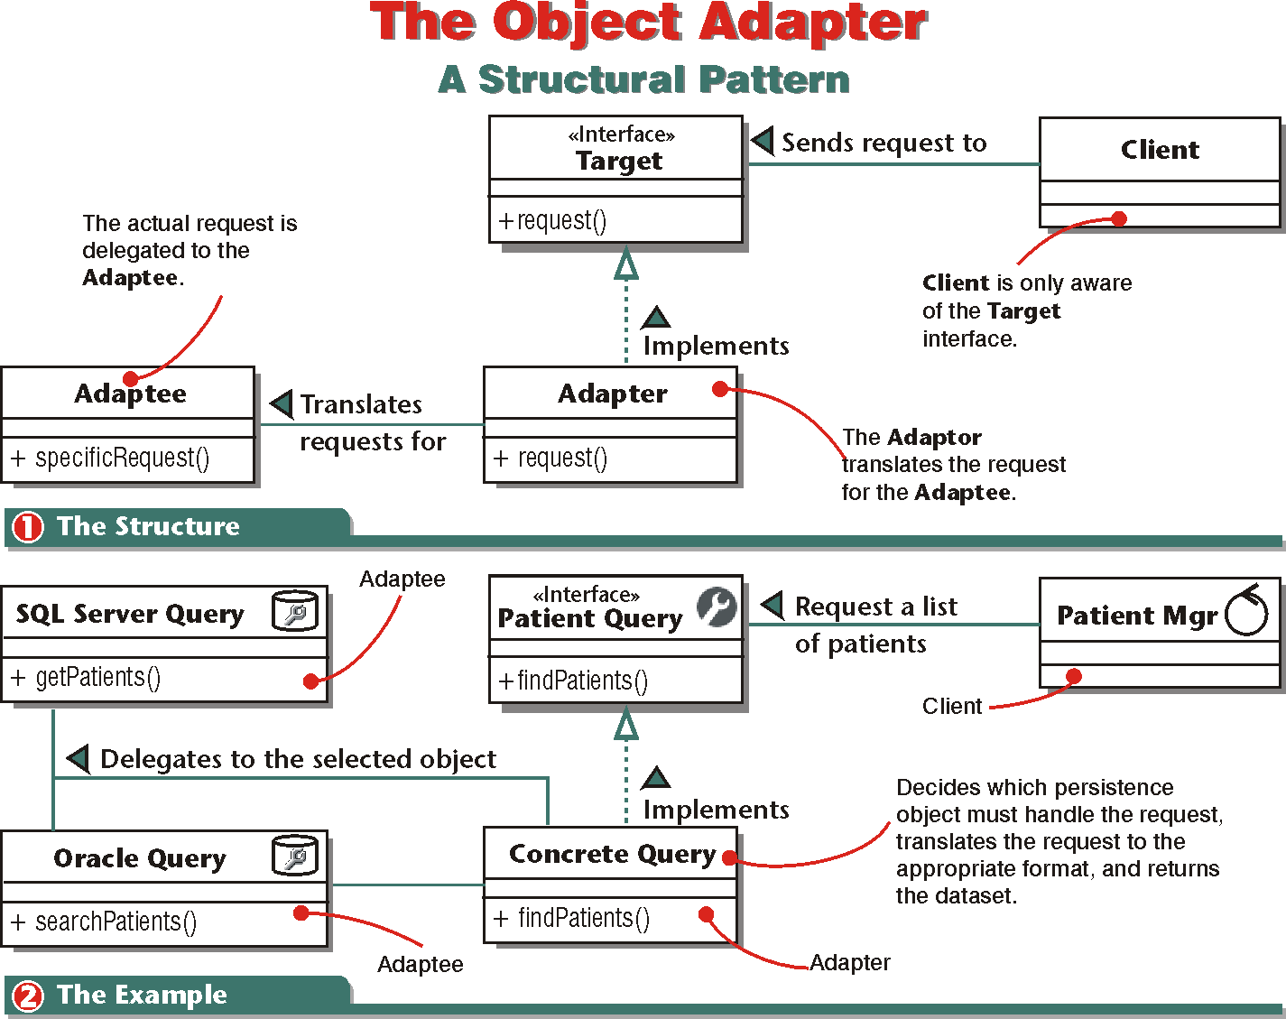
14- <number>

Slide 27
Measurement and Historical Mapping
Measurement and Historical Mapping patterns integrate bulk data gathering into an objected-oriented conceptual model.
14- <number>

Slide 28
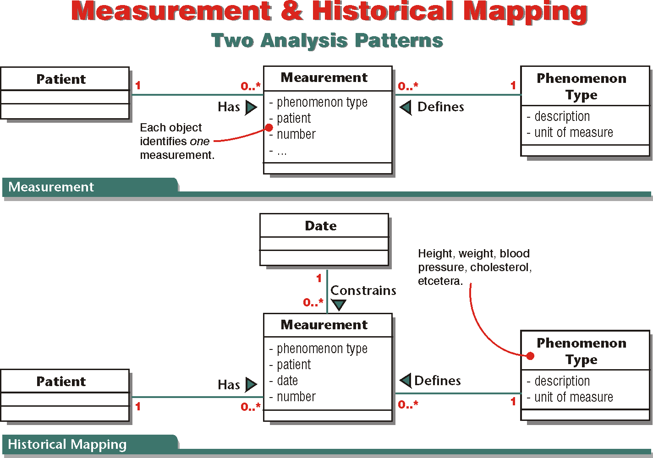
14- <number>

Slide 29
Modeling Patterns
Analysis patterns are concerned with the problem domain. Design patterns address the issues of the solution space. Modeling is neither the problem nor the product that solves the problem, but a “solution-as-method,” a means to an end, not an end by itself.
Modeling, however, has its own problems.
14- <number>

Slide 30
Dynamic Object Types
Dynamic object types are those that must change type to represent different but similar things at different times.
14- <number>

Slide 31
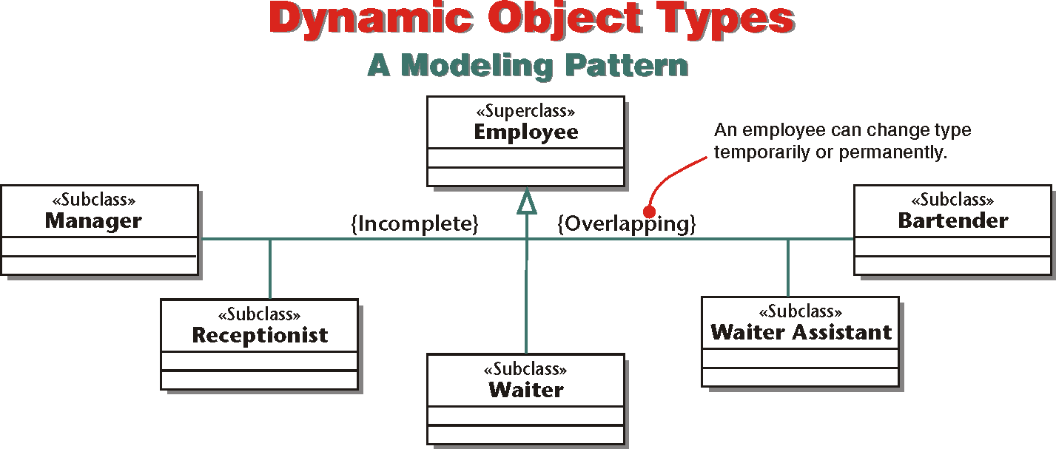
14- <number>

Slide 32
Anti-Patterns
Functional decomposition is to break down the functionality of a system into successively smaller tasks and subtasks until we reach the most atomic functions.
14- <number>

Slide 33
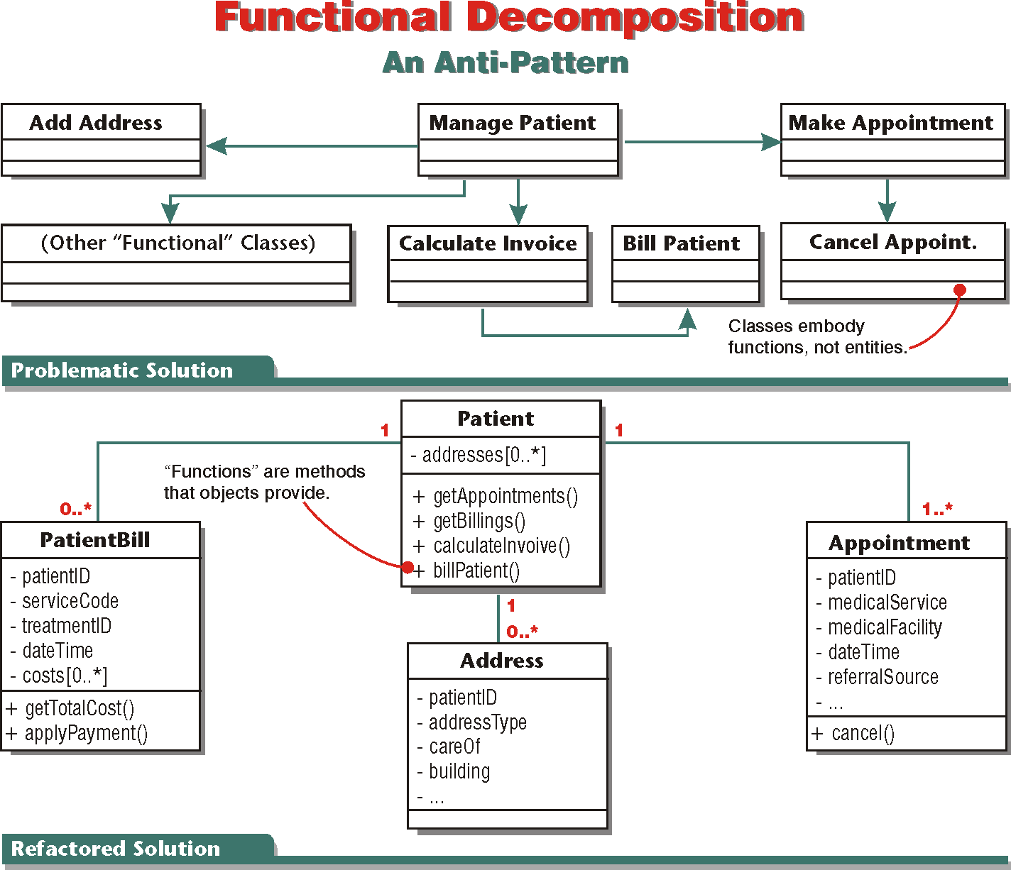
14- <number>

